Slide 1
Insert Image Here
Steps to
Financial Freedom & Building Your Budget
Presented By Courtney Burnham and Ashley Howard
Notes:
Insert your logo below the title
Thank you for joining us for this workshop, Steps to Financial Freedom
Speaker: Provide an introduction to yourself and your financial institution.

Slide 2
Today’s Agenda
01
Understand your Money Personality
06
Prepare Before Buying a Home
02
Set Financial Goals
07
Invest for Your Future
03
Creating and Adjusting Budget
08
Insure your Assets
04
Plan to Save
09
Keep Good Records
05
Use Credit Wisely
10
Reevaluate Regularly
Notes:
Today’s workshop will cover 10 steps to financial freedom. Financial freedom means something different to everyone, and these steps are designed to set you up to work towards whatever financial freedom means to you. Some steps may not apply to your definition of financial freedom and that is okay!
We’ll talk about understanding your money personality, setting financial goals, creating a budget, saving, using credit wisely, preparing to purchase a home, investing, insurance, record-keeping, and the importance of reevaluating your finances regularly.

Slide 3
Step 1: Understand your Money Personality
Money Personalities:
Hoarder: save, budget, prioritize
Spender: spend
Planner: one step at a time
Dreamer: big ideas, unsure how to make them happen
Risk taker: adventurous with money for potential gain
Risk avoider: tends to go with what’s for certain
Separatist: wants at least some money for oneself
Merger: wants to pool shared money together
Notes:
Do any of these money personalities sound like you? You might find that your approach to money is a combination of more than one of those personalities.
The hoarder likes to save, budget and prioritize while the spender likes to spend
The planner is the nitty-gritty, take-it-one-step-at-a-time type and the dreamer hatches passionate schemes, but has no idea how to make them come true
The risk-taker loves adventurous investing and on the contrary, the risk-avoider goes for the sure thing
The separatist wants at least some of his/her own money while the merger wants to pool all the couple’s money together
Engagement opportunity: ask a few audience members to share which money personalities resonate with them.

Slide 4
Step 1: Understand your Money Personality
How to determine your money personality:
List the products and services you enjoy spending your money on
What spending habits do you feel good about?
What changes would you like to make to your spending habits?
Notes:
At the same time, are there any spending habits you don’t feel as comfortable with and would like to change?
When you understand your money personality and attitudes toward money, this can help you consciously make adjustments and changes as needed to help you achieve your goals.

Slide 5
Step 2: Set Financial Goals
Goals should be:
Specific
Measurable
Reasonable & Realistic
Notes:
And finally, is your goal reasonable and realistic? You want to set yourself up to reach your goals! Don’t try to save so much each pay period that you don’t leave yourself sufficient money to cover your other expenses. You might have to lengthen your time frame to achieve a goal and decrease the amount you save each time to ensure your goal is realistic and can be reached. Remember, saving is a lifelong process, and a consistent, systematic approach will pay off.

Slide 6
Step 2: Set Financial Goals
How long will it take to achieve?
Short term: 2 years or less
Mid term: 2 to 5 years
Long term: 5 years or more
Notes:
Additionally, you can set long-term goals that you will probably be saving towards for quite a while, typically 5 years or longer, like a down payment to buy a house or enough money to retire comfortably.
Engagement: Ask the audience for some examples of a long-term goal.

Slide 7
Step 3: Create a Budget
What does a budget include?
Income
Expenses (fixed, variable, and periodic)
Debt payments
Notes:
Audience Engagement: How many of you have ever tracked your expenses in detail for three months? Was it fun? What did you learn?
In its most basic form a budget includes the money you have coming in and everything you need and want it to go back out towards. It is not until you know where your money really goes that you can make adjustments to your behavior and thus reduce or change expenses in order to free up money to save to achieve your goals.
If you don’t already have a budget, step 3 is to create one. Having and sticking to a budget is a key step to financial freedom. Start by identifying your income and debt payments, as those numbers tend to be similar from month to month. Then, work to get an understanding of your variable expenses which often seems to be the most challenging for people. Don’t forget to include periodic expenses in your budget such as car insurance or property taxes. Periodic expenses tend to sneak up on people because they are not budgeted for ahead of time. This can result in progress towards financial goals being derailed and potentially escalating debt.
People often find opportunities to save money by making small habit changes in a variety of expense categories. Identifying ways to change spending habits that will free up money to reach your goals can be exciting.

Slide 8
Step 3: Create a Budget
What might a budget look like?
RECOMMENDED MONTHLY EXPENDITURES
Category | Percent of Monthly Take-Home Pay
Housing | 25-35%
Food | 18-23%
Debt payments | 10-20%
Savings | 7-10%
Other expenses | 12-40%
Notes:
While these are recommended ranges as you set goals for your own budget, everyone’s budget can and will and should look different based on your financial situation and goals. I want to reiterate this: your budget should reflect your financial situation, your financial goals, and your financial priorities. If being able to go out to eat regularly is something that is a priority for you, it’s okay if your eating out budget is larger as long as you have accounted for it in your budget and are comfortable that your other needs are met and goals are being worked towards.
Creating a budget with your goals and situation and priorities in mind so that you are sure it is realistic for you to stick to is the biggest tip for creating a budget that works.

Slide 9
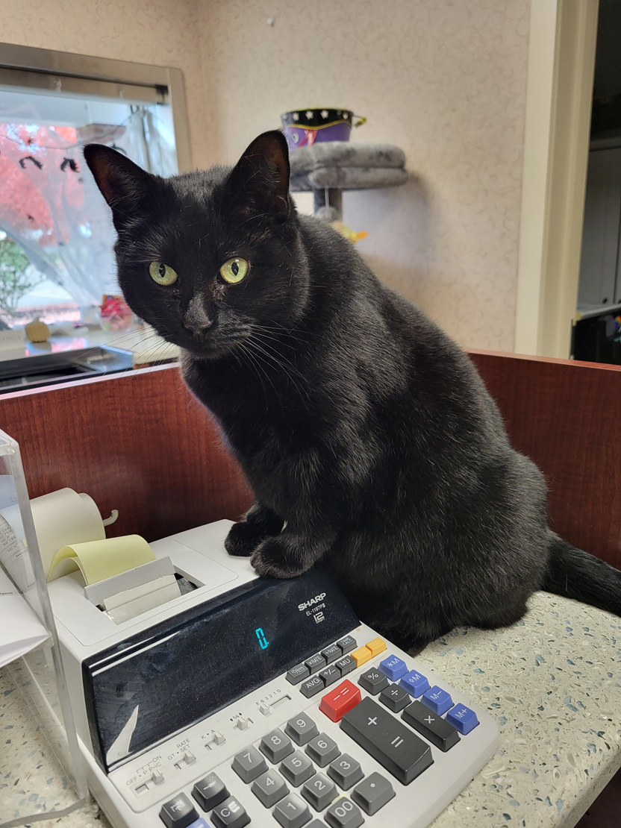
Step 3: Create a Budget
Steps to take:
List your income – how much money do you have to work with?
List your current expenses – where is your money going?
List future expenses – what would you like to be able to work towards in your budget?
Prioritize all current and future expenses – what is most important to you?
Work your way down the priority list until you run out of money
Notes:
Now it’s time to actually build your budget based on this! You know how much you have to work with – start working down your list of expenses and see how far you are able to get.
Presenter: allow attendees time to build their budget using the budget worksheet.

Slide 10
Step 3: Create a Budget
Steps to take:
Knowing spending priorities can help reduce the potential of adding to credit card balances. Check out GreenPath’s Aligning Priorities worksheet.
Set and stick to a shopping list. Take inventory of what you already have specific to products with high process and make a list of that you need.
Stay Flexible. Be flexible when it comes to timing your purchases. Do you really need that item right now? Wait for something to go on sale to buy it.
Notes:
Next up – what expenses would you like to add? This is where to list out the financial goals you would like your budget to be able to help you work towards. Putting money in savings, paying off debt more aggressively, taking on a new or increased payment of some type, whatever that may be – list it here.
Presenter: allow attendees time to list future expenses and the amount they’d like to spend on each.

Slide 11
Step 3: Adjusting Your Budget
Things to consider :
Review expense amounts – where might you be able to reduce spending to avoid having to cut any expenses out entirely?
The “Costly Cs”
Clothes
Cars
Cola
Coffee
Cable
Cinema
Cigarettes
Cell phones
Children’s expenses
Carry-out
Convenience
Notes:
Have you ever realized that many of the areas in our budget that many people find themselves overspending on all start with the letter C? Things like clothes, cars, coffee, cable, children’s expenses, convenience, and the list goes on.
Of course, not everything on this list will be items you personally spend money on or are areas you can adjust your spending on; however, it is worth evaluating if any of these make sense for you to consider reducing how much you spend on.

Slide 12
Step 3: Adjusting Your Budget
Things to consider:
Review expense amounts – where might you be able to reduce spending to avoid having to cut any expenses out entirely?
The “Costly Cs”
Subscriptions
Streaming services
Amazon Prime
Chewy
Food delivery services
Grocery delivery services
Magazines and newspapers
Music subscriptions
Wholesale/warehouse club stores
Subscription boxes
Notes:
Another area many people don’t even realize how much money goes to are subscriptions. Based on a 2022 survey, the average household spends $219 every single month on various subscriptions. This number may surprise many of us who cut cable and signed up for streaming services to save money!
Review your checking account and credit card statements to identify and list all the subscriptions you have and how much they cost each month. Be sure to include things like:
- Streaming services – Netflix, Disney+, Hulu, Paramount, Apple TV, HBO, Discovery+, etc
Amazon Prime
Chewy
Food delivery services – Uber Eats, DoorDash, GrubHub, Postmates
Grocery delivery services – Amazon Fresh, Walmart+, Instacart, Shipt, etc
Magazines and newspapers – print or online
Music subscriptions – Amazon Music, Apple Music, Pandora, SiriusXM, Spotify, etc
Box stores – Sam’s Club, Costco, BJ’s
Subscription boxes - Beauty, Style, Home, Food, Drink, Pets, Kids and Hobbies
Now that you have a full list of subscriptions you are currently paying for, ask yourself if you use the subscription enough to justify the cost. Perhaps you had a specific streaming service for just one show, and that season has now ended. Maybe you paid for a delivery service during the pandemic, but no longer use it much now that you are out and about more again.
If you are on the fence about how much you are using or may miss a subscription, consider cancelling it for one month then revisiting your decision at that time. You may realize you really missed it and want to re-enroll, or you may discover you didn’t miss it at all and are okay to leave it cancelled! Giving yourself a defined trial period with an end date to reevaluate can be a great way to make final decisions with confidence. Many subscriptions will let you pause versus fully cancelling, making it easier if you do decide to continue to subscribe.

Slide 13
Adjusting Your Budget
Things to consider:
Review expense amounts – where might you be able to reduce spending to avoid having to cut any expenses out entirely?
Review income – any opportunities to bring more money in?
Start over and work your way down the list again – are you able to fit everything in with these adjustments?
If not, repeat these three steps until you can
Today’s budget is a first draft: review it again!
Notes:
And finally – consider the budget you created today a first draft. Go home, sleep on it, then take a fresh look at it to see if you identify any immediate changes. Consider some of the things we are going to talk about in the tips for success as we wrap up. Talk with your financial partner or others in your household impacted by these decisions. Once you feel confident you have a budget in place you’d like to follow, then it’s time to start implementing it.

Slide 14
Tips for Success
Ease into changes gradually and stay mindful
Find a tracking method that works for you
Plan ahead for expected periodic expenses
Include emergency savings in your budget
Revisit your budget regularly, and make changes as your situation and goals change
Have grace with yourself!
You don’t have to do it alone – guidance is available
Notes:
And finally - you don’t have to do any of this alone! Our financial institution is here for you, and our trusted partners at GreenPath Financial Wellness are here to help as well. You can contact a certified Financial Wellness Expert to completed a confidential assessment to help your get started building a spending plan and looking for opportunities to make every dollar work toward your goals.

Slide 15
Step 4: Plan to Save
Successful Saving
Luna says its always a good idea to save money for emergency treats!
Include it in your budget
Have a separate emergency savings
Use sinking funds
Notes:
We mentioned periodic expenses before when talking about budgets. These may be things like regular car maintenance, holidays, birthdays, anniversaries, insurance, vacations, and other expenses you know you will have from time to time but not every month. Sinking funds are designed to help you be financially prepared for these unexpected expenses so you don’t find yourself caught off guard when they arrive.
Estimate how much money you will spend in the following year in each category, and divide those numbers by 12 to determine a monthly amount to save for each anticipated periodic expense. This helps you treat periodic expenses as monthly expenses in your budget. You can even take it one step further and divide each expense by the number of pay periods per year. If you get paid every other week, that is 26 paychecks per year. If you anticipate spending $1,000 during the holiday season, divide this by 26 pay periods and you’ll see that saving $38.50 per paycheck in your holiday spending fund will ensure you have $1,000 already available when the holiday season rolls around each year.
Consider either setting up a separate savings account for each sinking fund to ensure you are using this money for the intended purposes.
Engagement Opportunity: Using the workshop guide, ask attendees to start listing their own sinking funds and share what periodic expenses they plan to create a sinking fund for.

Slide 16
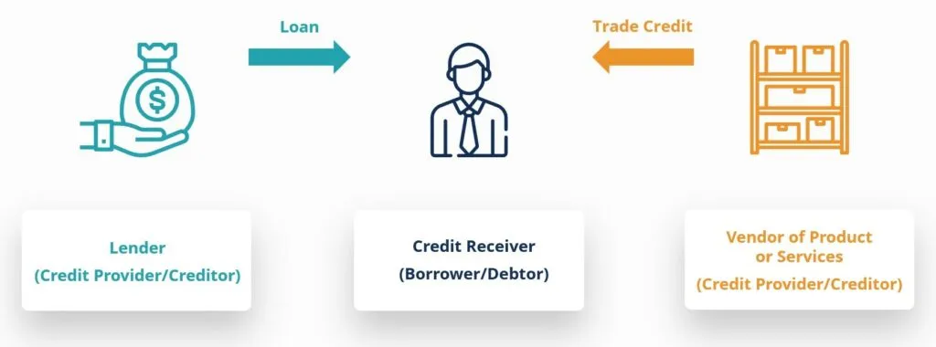
Step 5: Use Credit Wisely
Credit is:
Luna says its always a good idea to save money for emergency treats!
An agreement wherein someone received goods or services now with the understanding they will pay the creditor back later.
Notes:
We mentioned periodic expenses before when talking about budgets. These may be things like regular car maintenance, holidays, birthdays, anniversaries, insurance, vacations, and other expenses you know you will have from time to time but not every month. Sinking funds are designed to help you be financially prepared for these unexpected expenses so you don’t find yourself caught off guard when they arrive.
Estimate how much money you will spend in the following year in each category, and divide those numbers by 12 to determine a monthly amount to save for each anticipated periodic expense. This helps you treat periodic expenses as monthly expenses in your budget. You can even take it one step further and divide each expense by the number of pay periods per year. If you get paid every other week, that is 26 paychecks per year. If you anticipate spending $1,000 during the holiday season, divide this by 26 pay periods and you’ll see that saving $38.50 per paycheck in your holiday spending fund will ensure you have $1,000 already available when the holiday season rolls around each year.
Consider either setting up a separate savings account for each sinking fund to ensure you are using this money for the intended purposes.
Engagement Opportunity: Using the workshop guide, ask attendees to start listing their own sinking funds and share what periodic expenses they plan to create a sinking fund for.

Slide 17
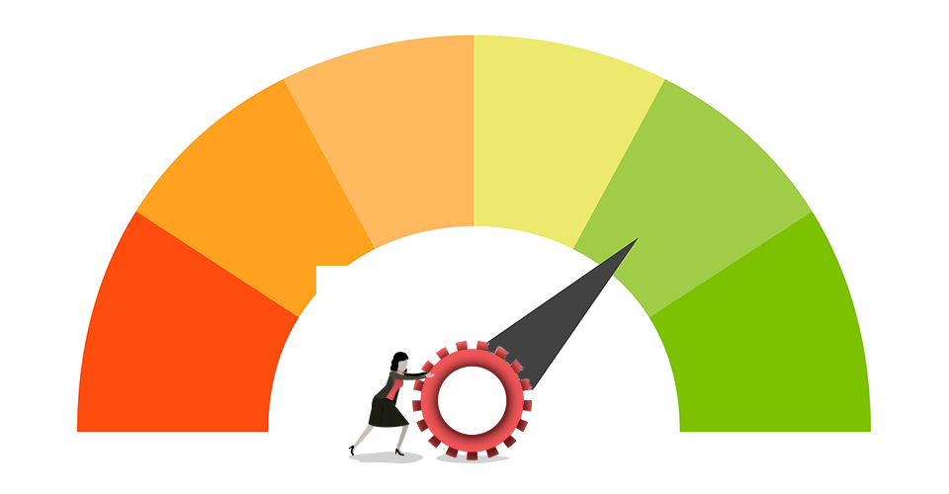
Step 5: Use Credit Wisely
A Credit Report is:
A statement that has information about your credit history and current credit activity, showing details of how you are currently and have previously managed credit accounts.
Generated and provided by three credit bureaus
Luna says its always a good idea to save money for emergency treats!
Notes:
We mentioned periodic expenses before when talking about budgets. These may be things like regular car maintenance, holidays, birthdays, anniversaries, insurance, vacations, and other expenses you know you will have from time to time but not every month. Sinking funds are designed to help you be financially prepared for these unexpected expenses so you don’t find yourself caught off guard when they arrive.
Estimate how much money you will spend in the following year in each category, and divide those numbers by 12 to determine a monthly amount to save for each anticipated periodic expense. This helps you treat periodic expenses as monthly expenses in your budget. You can even take it one step further and divide each expense by the number of pay periods per year. If you get paid every other week, that is 26 paychecks per year. If you anticipate spending $1,000 during the holiday season, divide this by 26 pay periods and you’ll see that saving $38.50 per paycheck in your holiday spending fund will ensure you have $1,000 already available when the holiday season rolls around each year.
Consider either setting up a separate savings account for each sinking fund to ensure you are using this money for the intended purposes.
Engagement Opportunity: Using the workshop guide, ask attendees to start listing their own sinking funds and share what periodic expenses they plan to create a sinking fund for.

Slide 18
Step 5: Use Credit Wisely
Tips for healthy credit use:
Remember: credit is a tool, not extra money.
Know your strengths and weaknesses, and plan accordingly.
Bulk up your emergency savings to avoid having to turn to credit to cover unexpected expenses.
Keep balances manageable and prioritize making all payments on time.
Keep an eye on your credit report for errors.
Notes:
And finally, be sure to check your credit report regularly for accuracy. You are entitled to obtain a free copy from each of the three credit bureaus every 12 months, and we encourage you to do so at AnnualCreditReport.com.

Slide 19
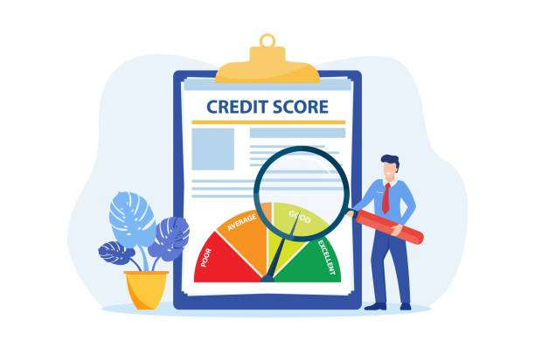
Step 5: Use Credit Wisely
Building Positive Credit History:
Make every payment on time every month.
Keep credit card balances low.
Only apply for new credit when you need it.
Don’t ignore bills – even if its incorrect or don’t think you owe it.
Review your credit report at least once every year at: AnnualCreditReport.com
Make every payment on time every month.
Notes:
And finally, be sure to check your credit report regularly for accuracy. You are entitled to obtain a free copy from each of the three credit bureaus every 12 months, and we encourage you to do so at AnnualCreditReport.com.

Slide 20
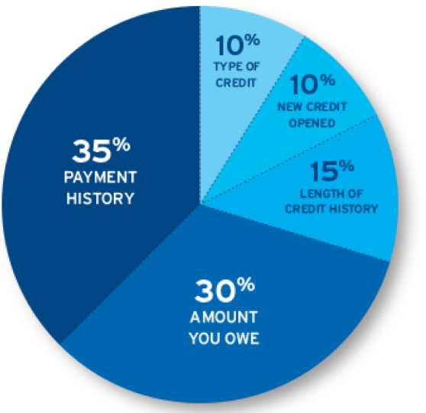
Step 5: Use Credit Wisely
How is My Credit Score Calculated?
The higher your credit score, the better. A high score indicates a lower perceived risk to lenders.
Your score is developed using credit data that is grouped into five categories.
Notes:
And finally, be sure to check your credit report regularly for accuracy. You are entitled to obtain a free copy from each of the three credit bureaus every 12 months, and we encourage you to do so at AnnualCreditReport.com.

Slide 21
Step 5: Use Credit Wisely
Common Credit Myths:
Myth: You need lots of open credit cards to build credit.
Fact: A variety of credit types is more important than the number of accounts. Typically, no more than two or three open credit cards are recommended.
Notes:
As we discussed earlier, know your money personality. If you are a spender or a risk taker, you may want to avoid carrying credit cards to avoid impulse buying. Create some clear guidelines you will use and develop an accountability system to stick to those guidelines.

Slide 22
Step 5: Use Credit Wisely
Common Credit Myths:
Myth: You must maintain a balance on your credit card from month to month to build credit.
Fact: You still build positive payment history when paying your balance in full. Paying off the entire balance you owe by your statement due date each month saves you money on interest charges and will allow you to maintain a healthy credit utilization.
Notes:
As we discussed earlier, know your money personality. If you are a spender or a risk taker, you may want to avoid carrying credit cards to avoid impulse buying. Create some clear guidelines you will use and develop an accountability system to stick to those guidelines.

Slide 23
Step 5: Use Credit Wisely
Common Credit Myths:
Myth: Checking your own credit report will hurt your credit.
Fact: You have the right to check your credit report for monitoring or educational purposes, which is a soft inquiry and will not hurt your credit. If you authorize someone to pull your credit report for the purpose of a loan or credit card, this is a hard inquiry, and may have negative impact.
Notes:
As we discussed earlier, know your money personality. If you are a spender or a risk taker, you may want to avoid carrying credit cards to avoid impulse buying. Create some clear guidelines you will use and develop an accountability system to stick to those guidelines.

Slide 24
Step 5: Use Credit Wisely
Common Credit Myths:
Myth: All credit scores are the same.
Fact: There are three credit bureaus and multiple credit scoring models. Know that your score may be different based on the specific report that’s being viewed and the scoring model that is being used. No matter what, maintaining healthy credit habits will create a stronger score over time.
Notes:
As we discussed earlier, know your money personality. If you are a spender or a risk taker, you may want to avoid carrying credit cards to avoid impulse buying. Create some clear guidelines you will use and develop an accountability system to stick to those guidelines.

Slide 25
Step 6: Prepare Before Buying a Home
How much can I afford?
Just because you are approved for a certain amount does not mean you can afford it!
Prepare for down payment, closing costs, and other up-front expenses
Qualifying Ratios lenders use:
Housing: 28% or less of gross income
Debt: 36% or less of gross income
These may vary based on lender or loan type
Notes:
Most lenders prefer you to spend no more than 28% of your gross monthly income (before deductions) on principal, interest, taxes, and insurance for your new mortgage payment. Add this anticipated payment to your other monthly debts, and they typically don’t want that amount exceeding 36% of your gross income. These calculations are known as your debt-to-income ratio. In addition to your credit score, the debt-to-income ratio is weighed heavily in a mortgage lender’s decision.
Engagement activity: what are some debts that would fall under this debt-to-income ratio?
Mortgage
Car payment
Student loan payments
Credit card payments
Installment loan payments
To reiterate, this ratio doesn’t consider other expenses you might have outside of debt payments. You may have additional large expenses like childcare which is why it is imperative for you to know what payment your overall budget can support, regardless of how much a mortgage lender says you could afford to pay because they are not typically looking at your entire picture.

Slide 26
Step 7: Invest for Your Future
Types of Investments
Stocks – partial ownership in a company
Bonds – you are the lender with a promise of repayment with interest
Mutual funds – pool your money & diversify
Retirement plans – IRA, 401(k), 403(b)
Notes:
401(k)s and 403(b)s are retirement savings plans offered by employers for their employees. For government employees, the 401(k) equivalent is the Thrift Savings Plan, or TSP. The money saved in these plans is before tax, and the investments grow tax-free. Withdrawals in retirement are then taxed as income at that time.
As part of their benefit plan, some employers offer a match to encourage employees to contribute to these savings plans. Since this employer match is essentially free money for your future, prioritize making room in your budget to contribute enough to receive the full match every year to maximize this benefit.
Consider automatically increasing the amount you contribute to your retirement plan when you get a raise. Some employers will automate these increases for their employees on an annual basis.
Know there are limits on how much the government allows us to contribute to our retirement plans, and these can change each year, so check out annual limits.
Two other Retirement savings accounts are the traditional IRA - Individual Retirement Account - and the Roth IRA. As implied by the name INDIVIDUAL Retirement Account, these plans are a great options for people that don’t have access to an employer retirement savings plan such as a 401(k).
The traditional IRA is similar to the 401(k) in that contributions are tax-free, investments grow tax-free, and withdrawals are taxed as regular income. The ROTH IRA contributions are made after taxes are deducted, at which point investments grow tax-free, and withdrawals are also free of tax. Roth IRAs can also be used by people without access to an employer plan.
https://www.irs.gov/retirement-plans/401k-plans

Slide 27
Step 8: Insure your Assets
Types of Insurance to Consider:
Auto
Renters/Homeowners
Health/Dental/Vision
Life
Disability/Long Term Care
Notes:
Long-term disability insurance is intended to cover lost wages due to a disability and can last a specific term or until you are eligible to draw Social Security.
Long-term care insurance will cover a daily amount for services to assist with activities of daily living. The cost of long-term care can vary greatly depending on age, reimbursement amount, and other optional benefits.
https://acl.gov/ltc/costs-and-who-pays/what-is-long-term-care-insurance#:~:text=Some%20policies%20will%20pay%20the,that%20have%20no%20such%20limits.

Slide 28
Step 9: Keep Good Records
Retaining Records:
Tax Returns – 3 years from the date you filed your original return or 2 years from the date you paid the tax, whichever is later.
Bank Statements: 1 year, but the length of time you should keep them depends on your individual circumstances.
Pay Stubs: 3 years from the date you filed your tax return.
Notes:
If you prefer to store your documents digitally, make sure you choose an encrypted and backed up storage option so you don’t lose access to important paperwork.

Slide 29
Step 9: Keep Good Records
Getting Organized:
Paper files: keep in a fire proof safe or filing cabinet.
Digital Storage: keep it secure with a password that does not contain any personal information such as name, dob, SSN, employer, spouse or child or pet's name.
Notes:
If you prefer to store your documents digitally, make sure you choose an encrypted and backed up storage option so you don’t lose access to important paperwork.

Slide 30
Step 10: Reevaluate Regularly
Reevaluation Cadence:
Quarterly
Budget
Savings contributions
Notes:
We also encourage you to quarterly evaluate how much you are contributing to savings and determine if you can increase that amount. This is especially important when you are just beginning to build those savings muscles into your budget and are starting with a small amount as you get in the rhythm of a budget.

Slide 31
Step 10: Reevaluate Regularly
Reevaluation Cadence:
Annually
Credit Report
Financial Goals
Investments
Insurance policies
Records
Notes:
And finally, whether you store your records physically or digitally, go through your records at least once a year to make sure they remain organized and up to date. Consider which records you may be able to securely dispose of.

Slide 32
Questions
Credit Union Contacts:
Luna says don’t pull your hair out, FLHC is here if you have any questions!
Courtney Burnham
Membership Specialist
cburnham@flhc.com
607-733-1304 (phone/text)
Ashley Howard
Loan Supervisor
Certified CU Financial Counselor
ahoward@flhc.com
607-733-1304 (phone/text)
Luna – Credit Union Kitty
TikTok: creditunionkitty
Notes:
And finally, whether you store your records physically or digitally, go through your records at least once a year to make sure they remain organized and up to date. Consider which records you may be able to securely dispose of.

Slide 33
GreenPath Financial Wellness
Speak with a Financial Wellness Expert:
877-337-3399
Learn more at: my.greenpath.com
Notes:
You can contact GreenPath at 877-337-3399 or learn more at:
(Presenter: change this to your cobranded URL)

